Slide 1
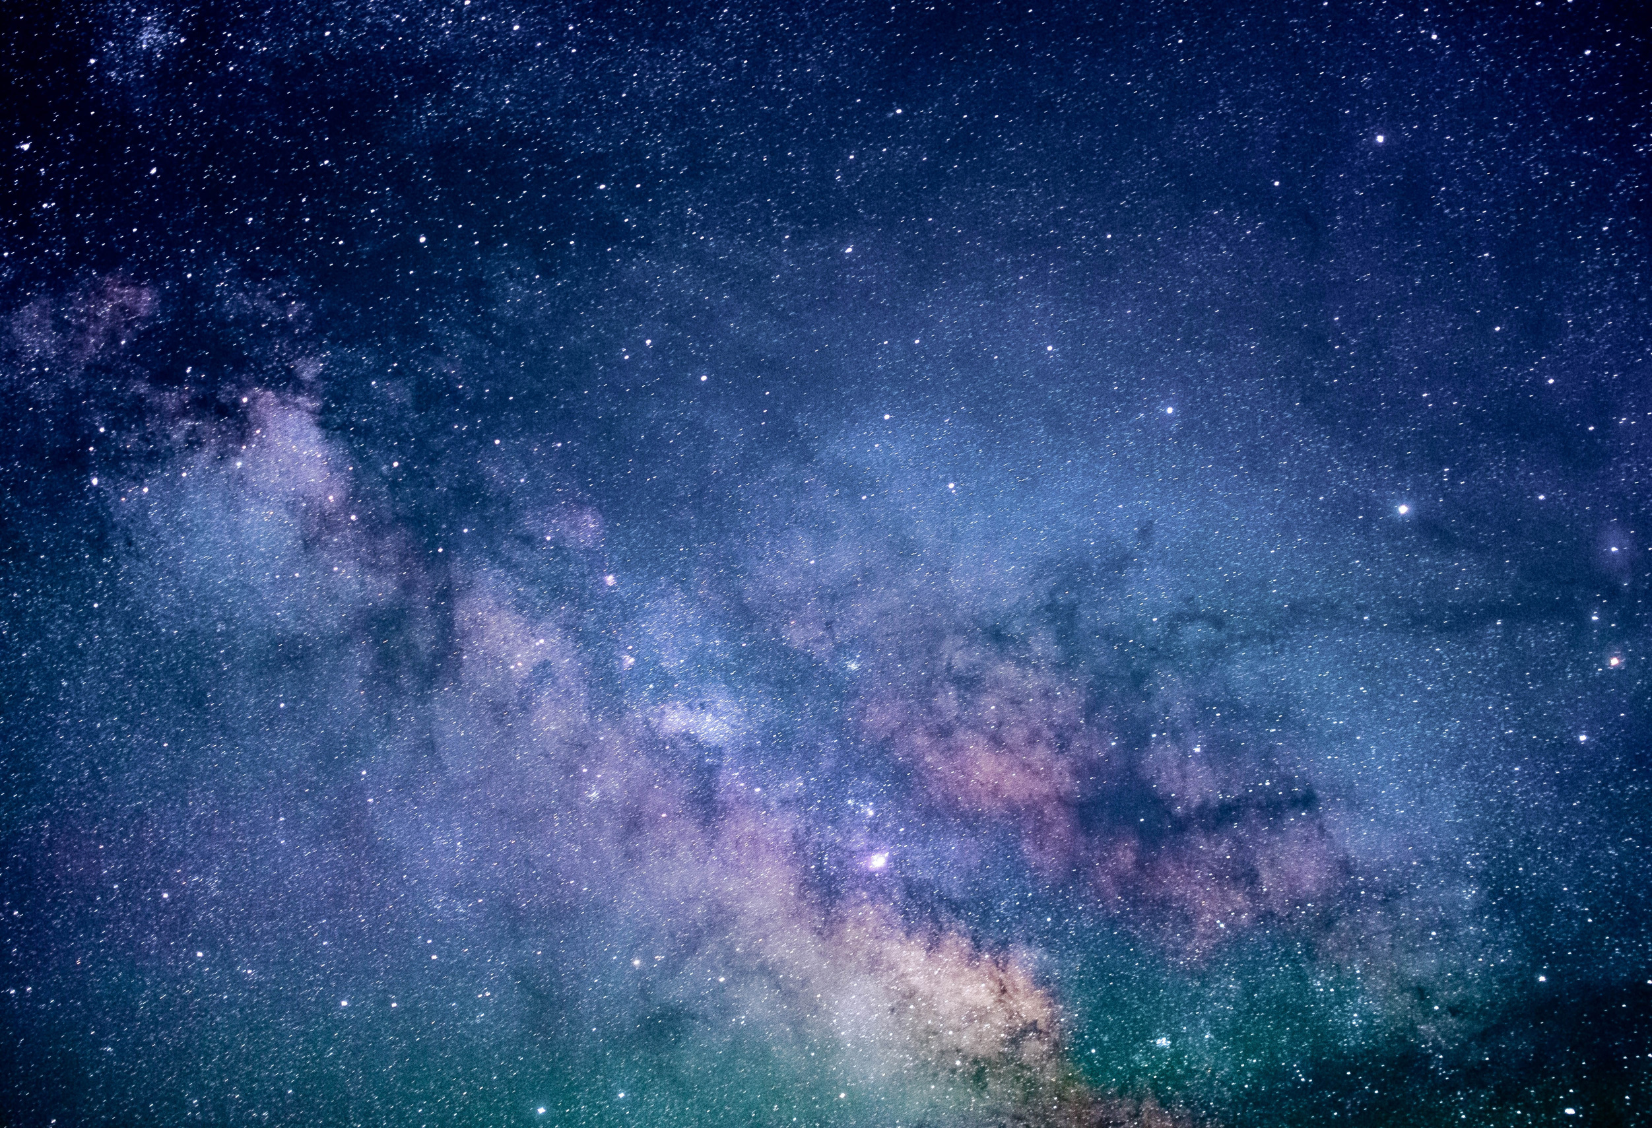

-A StarGazing Service-
StarScope

Slide 2
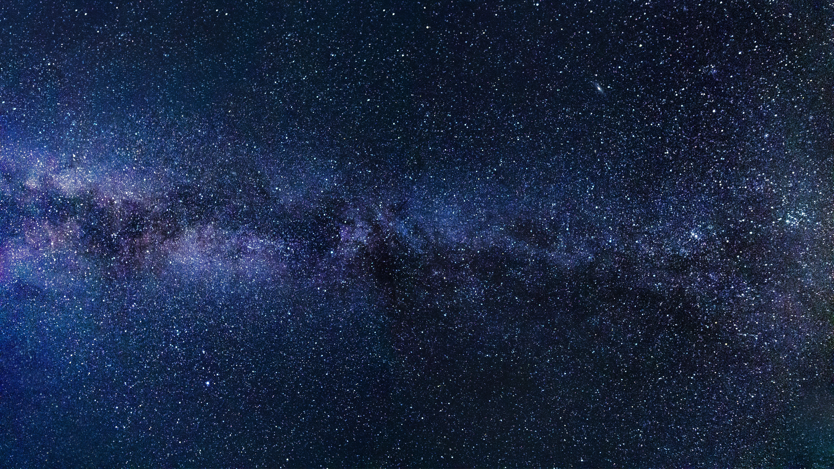
The universe:
City full of stars

Slide 3
Introduction to our app
StarScope is a premium stargazing and astrophotography service aiming to make astronomy accessible to everyone. They conduct guided telescope touns astrophotography sessions, and online live streams of celestial events. Their mission is to spark curiosity about space and make night-sky exploration a memorable experience for all age groups.

Slide 4

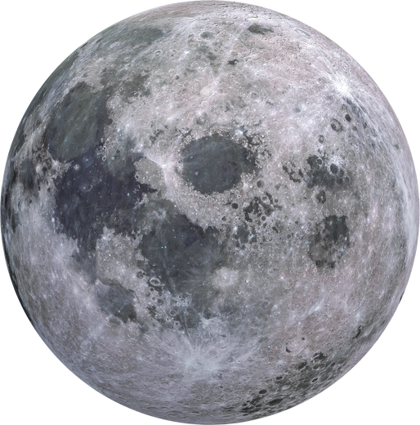
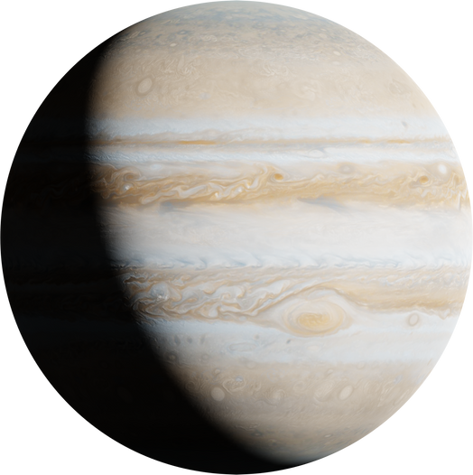
Applications used
HTML
CSS
AI Application used
- Copilot

Slide 5
Thank you very much!

